Slide 1

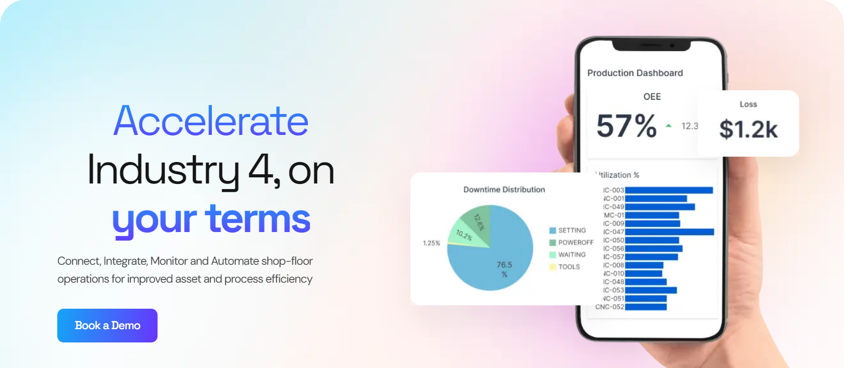
Project Review
Shakthi Mahendira K
20PD10

Slide 2
Special Thanks
Dr. R. Nadarajan, Director,
Department of Applied Mathematics and Computational Sciences, PSG College of Technology.
Dr. Shina Sheen, Head of the Department,
Department of Applied Mathematics and Computational Sciences, PSG College of Technology.
Dr. M. Senthil Kumar, Course Coordinator,
Department of Applied Mathematics and Computational Sciences, PSG College of Technology.
Dr. M. Thilaga, Tutor,
Department of Applied Mathematics and Computational Sciences, PSG College of Technology.
Dr. M. Megala , Academic Guide,
Department of Applied Mathematics and Computational Sciences, PSG College of Technology.
Mr Hemanand, External Guide,
Founder CEO at MachDatum Pvt. Ltd.

Slide 3
Agenda
Introduction to Organization
Work Environment
Project Details
My Contribution
Tools and Technology Used
Q & A

Slide 4
Introduction to Organization
● MachDatum,is a startup in Coimbatore, specializes in crafting and implementing Industry 4.0 solutions for manufacturing and process sectors. Their expertise lies in enhancing and maintaining equipment and process efficiency.
● They harness a blend of advanced technologies including the Industrial Internet of Things (IIoT), Data Engineering, Machine Learning, and Artificial Intelligence to drive transformative outcomes.
● Prestigious MNCs like ZF Wind Power and Shanthi Gears are among MachDatum’s esteemed clients

Slide 5
Work Environment
Hardware Specifications
Processor - intel i7 10th Gen
Ram- 8GB
Software Specifications
OS Windows 11

Slide 6
Bator Operator
The Bator operator is employed for real-time digital surveillance of the shop floor.
Machine-generated raw data is seamlessly relayed to the Bator operator's display.
This interface presents both contextual information and the machine's operational cycle, offering an in-depth insight into its current performance.
By integrating CNC machines, operations become more efficient, minimizing the necessity for manual intervention.

Slide 7
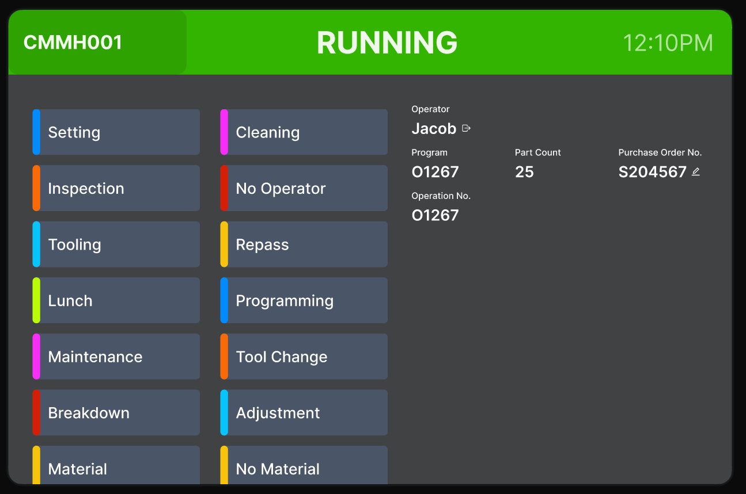
Operator Screen

Slide 8
Bator Engine
The Bator Engine is employed to oversee the operational dynamics of CNC Machines.
Within the Bator Engine, we analyze the machine's active and inactive periods to ascertain the OEE value.
OEE, or Overall Equipment Effectiveness, stands as the benchmark in gauging manufacturing efficiency.
The formula for OEE is given by: OEE = Availability × Performance × Quality.
Various metrics are used to compute the OEE, ensuring a comprehensive understanding of production effectiveness.

Slide 9
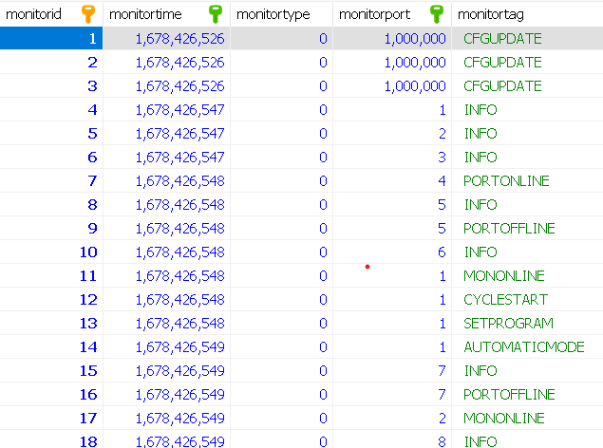
Data From CNC Machine

Slide 10
ThingPlatform
ThingPlatform offers a seamless transformation of data into dynamic visualizations, providing businesses with a quick and efficient way to interpret and interact with their information.
Its user-centric approach sets it apart from established giants like PowerBI, focusing on intuitive design and straightforward processes to cater to a broad range of users, not just data scientists.
ThingPlatform empowers businesses, regardless of their size or tech expertise, to harness the full potential of their data, ultimately enabling better-informed decisions and insights.

Slide 11
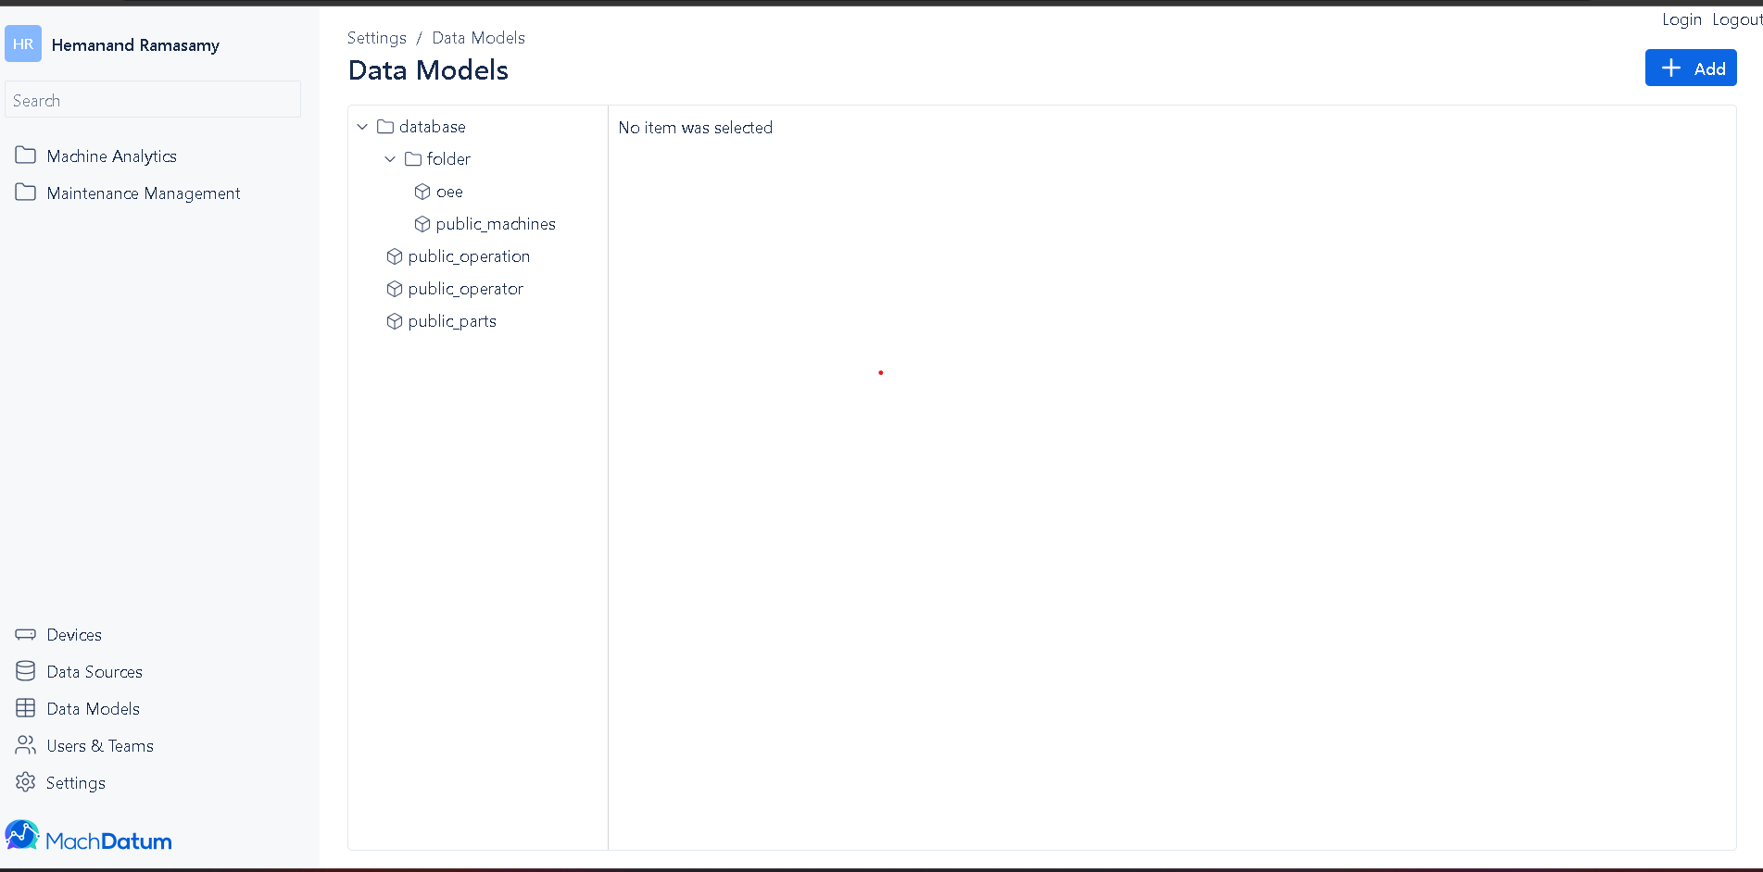

Slide 12
My Contribution
Code Efficiency Improvements:
Reduced the number of SQL commands executed in the database by utilizing dictionaries.
Developed new functions to decrease the code length.
Transitioned state files from text format to the database.

Slide 13
Enhancements to Data Segmentation and Reporting:
Introduced two new feature: "Reports".
Data will be segmented into shifts to calculate the OEE value for each shift.
"Reports" is a new table where the duration of each status will be stored in JSON format.

Slide 14
Refinement of Reporting and OEE Calculation Methods:
Previously, reports were generated using multiple joins from tables in the database. Now, we have a dedicated "reports" table.
OEE is now calculated machine-wise, month-wise, and shift-wise.
Generating OEE Reports
Generating Downtime Reports

Slide 15
Operator Screen Enhancements:
Developed a responsive UI for the Bator Operator Screen.
Designed the header section for the screen.
Added a "Downtime" button to the screen.

Slide 16
Api for users
Admin-Centric API:
Admin-focused actions: add, delete, update user profiles, and reset passwords.
Centralized control for efficient user management, ensuring security and compliance.
Centralized User Management API:
Streamlines user processes for administrators.
Endpoints for retrieving all users, suspending/activating accounts, and role modifications.
User-Driven Access API:
User actions: update personal info, change passwords, and manage profiles.
Empowers users with self-service functionality, enhancing convenience and satisfaction.

Slide 17
User Form
User-Focused Design: Designed user and user profile forms with a user-centric approach, ensuring an intuitive and user-friendly experience.
Comprehensive Data Handling: Developed forms that encompass a wide range of functionalities, including user registration, profile updates, password changes, and more.
Seamless Integration: Integrated these forms seamlessly with the frontend and backend systems to facilitate efficient data capture, submission, and management.

Slide 18
API for teams
Team API Creation: Designed an API for teams, simplifying team setup and management.
Access Control: Implemented role-based access controls within the API, ensuring secure data access for team members.
User-Friendly Interface: Crafted an intuitive interface for seamless team collaboration and resource sharing.

Slide 19
Building a Schema for Data Sources
Migrations for Schema: Utilized migrations to define and create the structured "datasource" schema, enabling version control and adaptability.
Repository Pattern: Implemented a repository pattern to encapsulate data access logic, offering methods for adding and updating datasources while abstracting database interactions.
API Controllers: Developed API controllers to handle HTTP requests, creating endpoints for datasources' addition and updates, with validation and error handling for data accuracy.

Slide 20
Building a Schema for Data Model
Define Data Model Structure:Identify the core attributes and relationships that constitute a data model and create a structured schema to represent this in a database.
Migrations for Data Model:Use database migrations to define and version the data model schema, allowing for easy updates and rollbacks.
Repository for Data Model:Implement a data model repository to encapsulate data access logic, providing methods for CRUD operations and abstracting database interactions.
Controller for Data Model:Develop an API controller to handle HTTP requests related to the data model, creating endpoints for retrieving, creating, updating, and deleting data model entities.

Slide 21
Import and Transform Data Model
Importing Data Model:Create mechanisms to import data model tables directly from a data source, offering users a straightforward way to use existing tables as data models.
Data Transformation:Develop a data transformation feature that allows users to customize existing tables through SQL queries to form new data models, providing flexibility in data modeling.
Migrations for Import/Transform:Extend the migration system to include scripts for importing data models and applying SQL transformations, ensuring version control and traceability.
Validation and Testing:Implement validation checks and testing procedures for imported and transformed data models, ensuring data integrity and compatibility with the application.

Slide 22





Tools and Technologies

Slide 23


ANY
QUESTIONS?

Slide 24
Thank You

